Slide 1
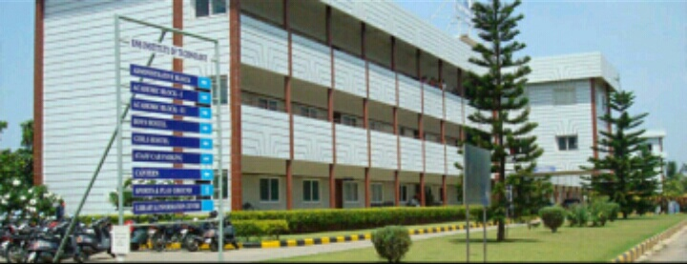

RNS INSTITUTE OF TECHNOLOGY
DEPARTMENT OF INFORMATION SCIENCE AND ENGINEERING

Slide 2
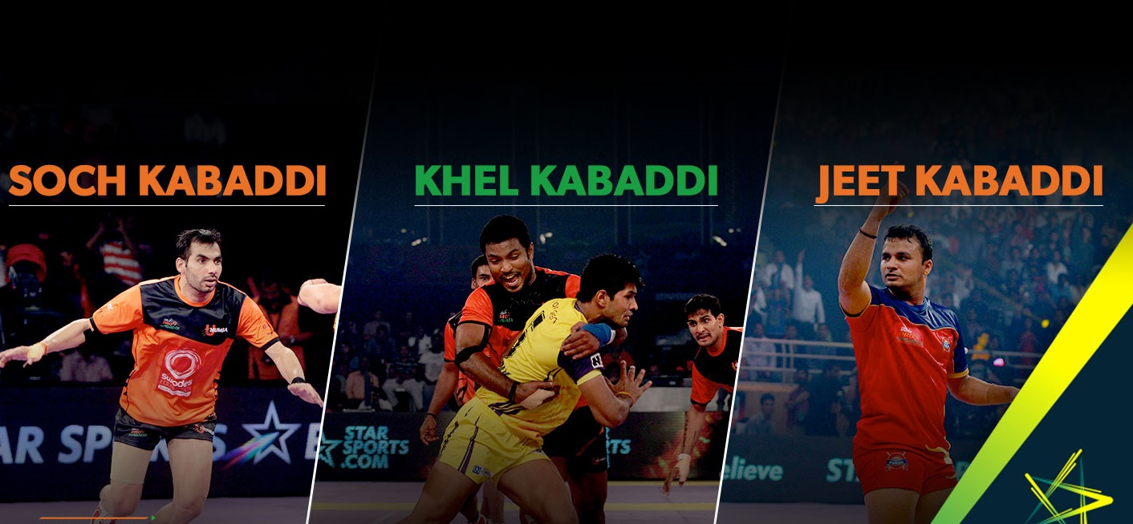
FILE STRUCTURES LABORATORY (15ISL68) TITLE : FOOD DISTRIBUTION MANAGEMENT SYSTEM USING HASHING
NAME: HARSHINI B PRANITHA KUMARI
USN: 1RN15IS030 1RN15IS062
SEMESTER: VI VI
SECTION: A A

Slide 3
INTRODUCTION TO FILE STRUCTURES:
File Structure is a combination of :
(i)Representation of data in files.
(ii)Ways of accessing data from the file.
Difference between file structures and data structures:
File structures refers to organizing the data in
hard disk.
Data structures refers to organizing
the data in memory.

Slide 4
GOALS OF FILE STRUCTURES :
GENERAL GOALS:
(i)Access the data in one trip to the disk.
(ii)Get the data in minimum trips.
(iii)Get all related data together in same trip.
PRIMARY GOALS:
(i)Minimizing the accessing time.
(ii)Maximizing the space utilization.

Slide 5
APPLICATIONS:

Slide 6
An interesting possibility for databases within the sports administration stream is in the scoring of athletes competing in judged sports, retrieving match details, information retrieval about the athletes and their respective teams.
The particular sport discipline considered for this project is PRO KABADDI.
PRO KABADDI LEAGUE is a professional-level kabaddi league in India which was established in 2014.
This web application allows us to store and retrieve the details of players , teams participated in different seasons and also the match details.

Slide 7
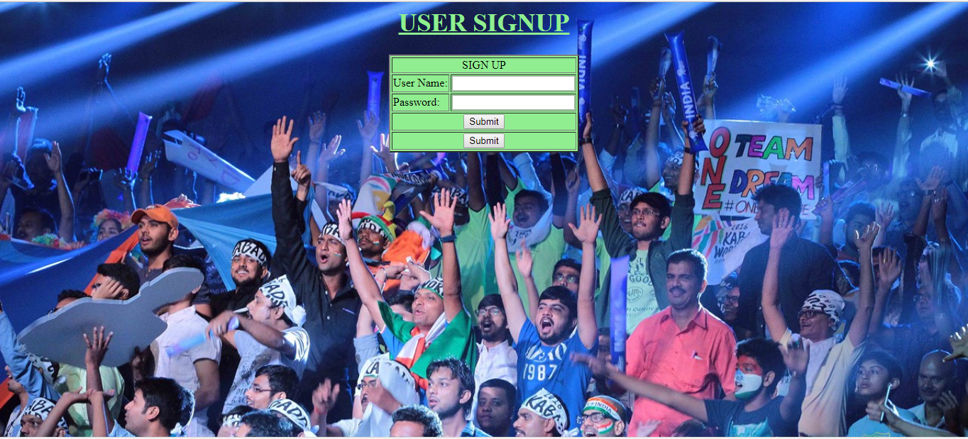
DESCRIPTION
WEB APPLICATION ACCESS
USER SIGN UP: Allows user to register for successful access of the database application.

Slide 8
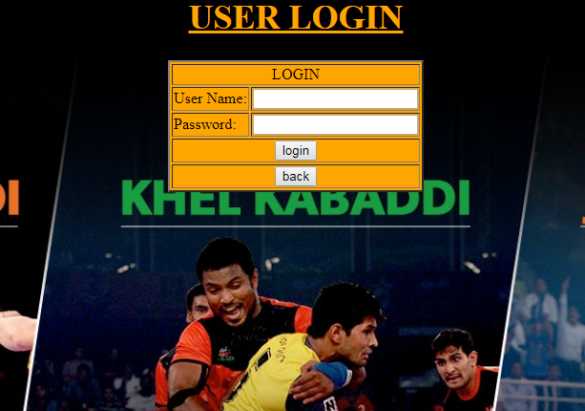
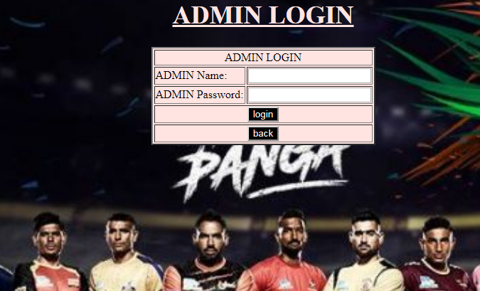
USER LOGIN: On successful registration ,the user can login upon validation with the registered data.
ADMIN LOGIN: Allows only the admin to login on comparison with the details stored in the database.

Slide 9
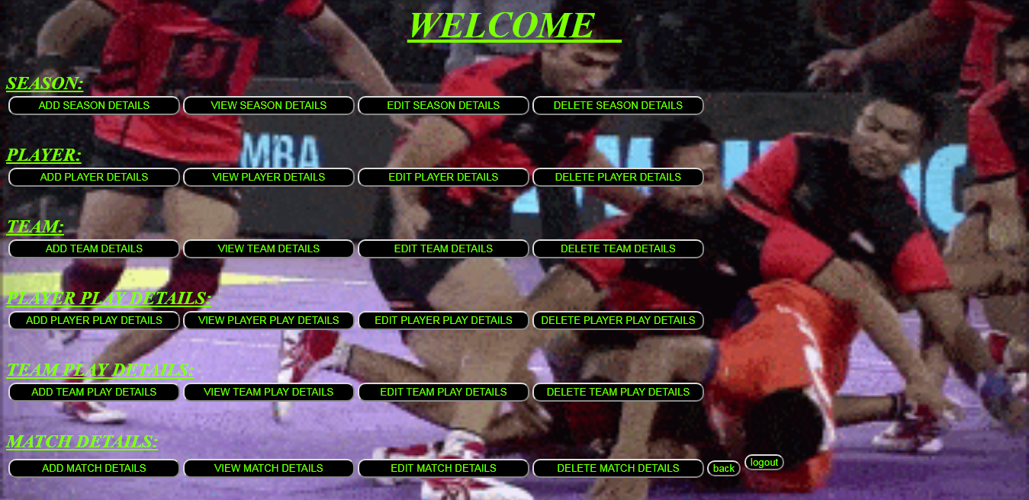
ADMIN MENU : Allows the admin to perform create , insert , update , delete(CRUD) operations on all the tables of the database

Slide 10
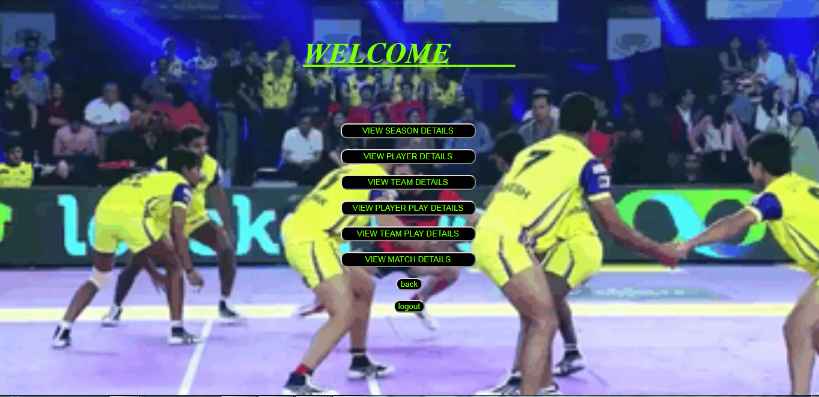
USER MENU :Allows the user to just view the data stored in the database (restricted from performing create/edit/delete operations)

Slide 11
REQUIREMENT SPECIFICATION
SOFTWARE REQUIREMENTS:
System Software : Windows 7
Web development environment : WAMP- consisting of Apache (web server), MySQL(database),
PHP(server side scripting language)
HARDWARE REQUIREMENTS:
Processors : Intel Pentium
RAM : 64MB
Storage : 10GB

Slide 12
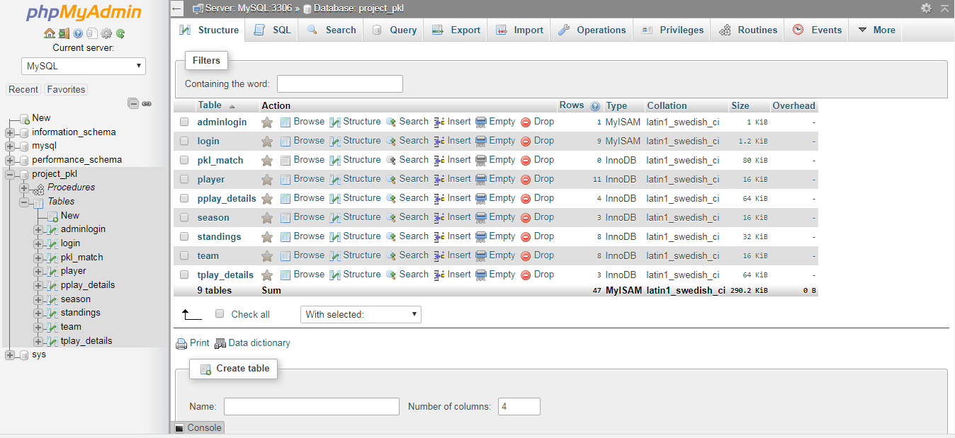
TABLES CREATED:ADMIN_LOGIN, USER_LOGIN,PLAYER,TEAM,SEASON, PLAYER_PLAY_DRETAILS,TEAM_PLAY_DETAILS,MATCH_DETAILS

Slide 13
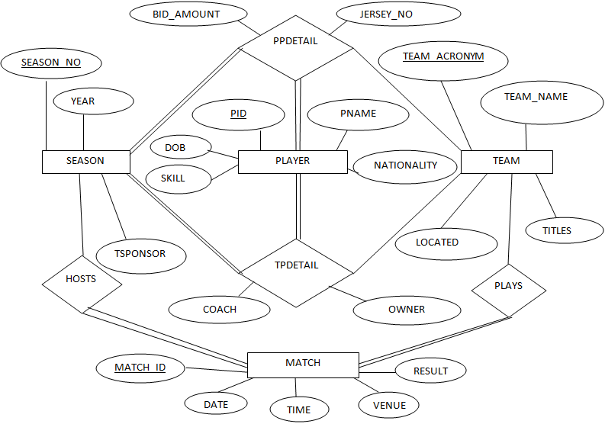
ENTITY RELATIONSHIP DIAGRAM
n
m
1
m
1
1
n
1
n
n

Slide 14
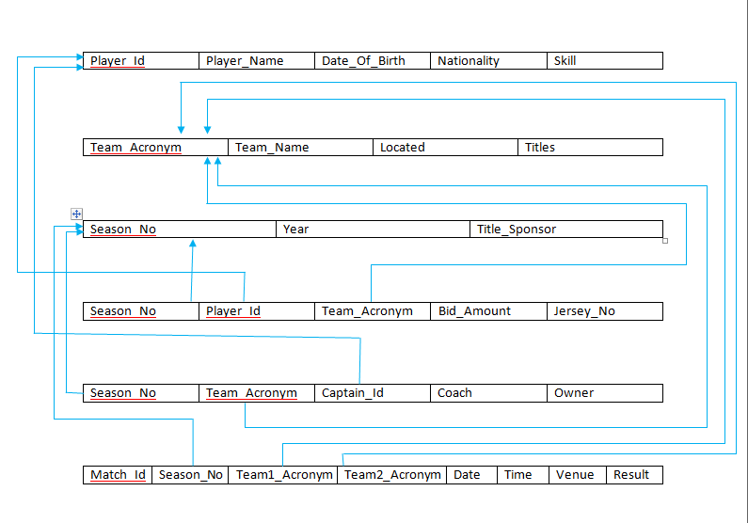
SCHEMA DIAGRAM
PLAYER
TEAM
SEASON
PP DETAIL
TPDETAIL
MATCH

Slide 15
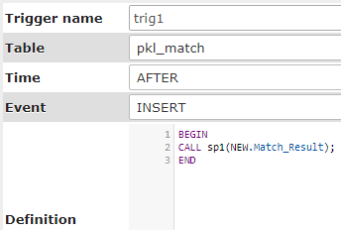
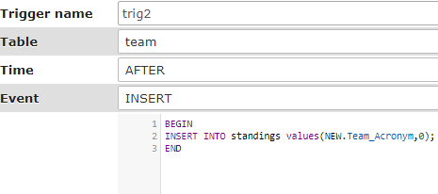
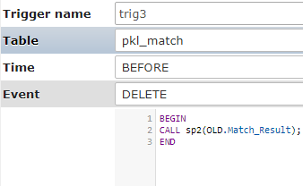
Triggers Implementation:

Slide 16
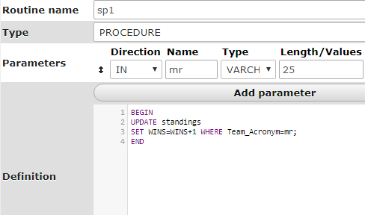
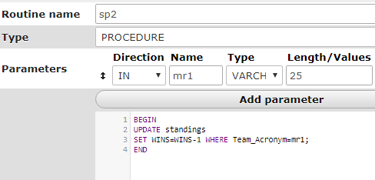
STORED PROCEDURES IMPLEMENTATION:

Slide 17
APPLICATIONS:
The web application can be adopted to any specific or general sporting events.
Can be adopted by any school/college sports department to maintain the athletes and their participation details.

Slide 18
Conclusion:
The developed web application enables effective storage and retrieval of the data stored in the database with a simple user interface.
FUTURE ENHANCEMENT : Multimedia database application could be developed which shows the visualiation of the details thus enabling a better understanding and analyzation of the data

Slide 19
REFERENCES:
[1]Fundamentals of Database Systems , RamezElmasri and Shamkant B.Navathe,7th Edition,2017,Pearson.
[2]Database management systems,Ramakrishnan,Gehrke,3rd Edition,2014,McGrawHill
[3]Websites : www.stackoverfow.com
www.w3schools.com

Slide 20
THANK YOU

